Slide 1
Rebuilding the Password Game
CS 119

Slide 2

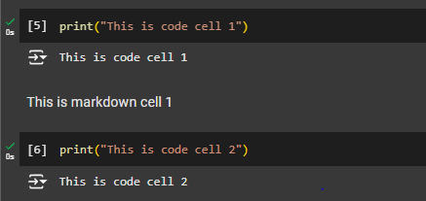
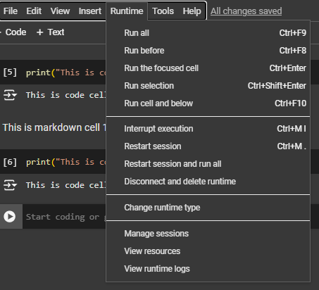
Google Colab
Interactive Python Notebook with Collaborative Features!
Composed of blocks of codes/markdown (text) that can be executed separately

Slide 3
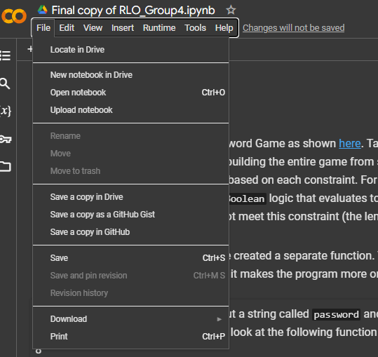
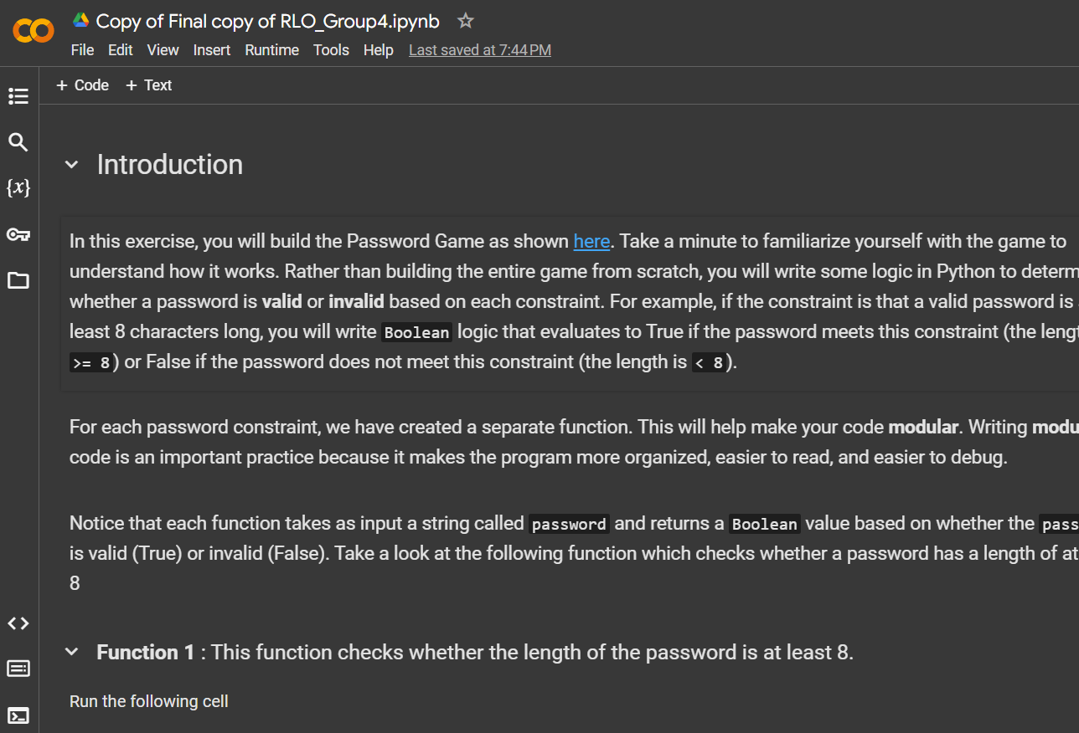
Filling in the Code
Survey/Attendance
Launching the Notebook
Launching the Script
Downloading and Saving the Notebook
Make sure you are logged into your gmail/UMass account

Slide 4
Filling in the Code
Survey/Attendance
Launching the Notebook
Launching the Script
Downloading and Saving the Notebook
Take a moment and go through the guiding text in the notebook

Slide 5


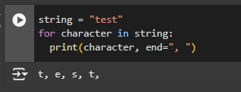

Filling in the Code
Survey/Attendance
Launching the Notebook
Launching the Script
Downloading and Saving the Notebook
Extract each character from string
Check if character is a digit

Slide 6
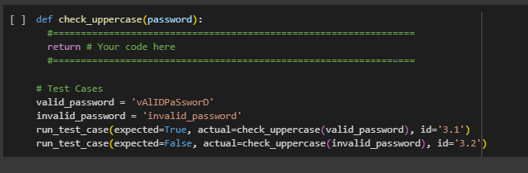
Filling in the Code
Survey/Attendance
Launching the Notebook
Launching the Script
Downloading and Saving the Notebook
Extract each character from string
Check if character is a Uppercase
Hint : use isupper() method

Slide 7

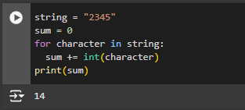
Filling in the Code
Survey/Attendance
Launching the Notebook
Launching the Script
Downloading and Saving the Notebook
Extract each character from string
If the character is a digit, include it in sum

Slide 8
Filling in the Code
Survey/Attendance
Launching the Notebook
Launching the Script
Downloading and Saving the Notebook
Take a moment and go through the prompts for check_even_numbers function

Slide 9
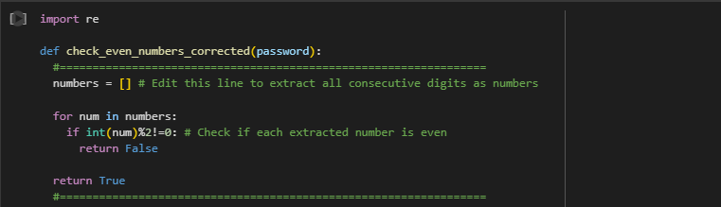
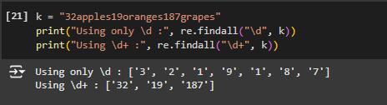
Filling in the Code
Survey/Attendance
Launching the Notebook
Launching the Script
Downloading and Saving the Notebook
How to use re.findall to extract all numbers?

Slide 10
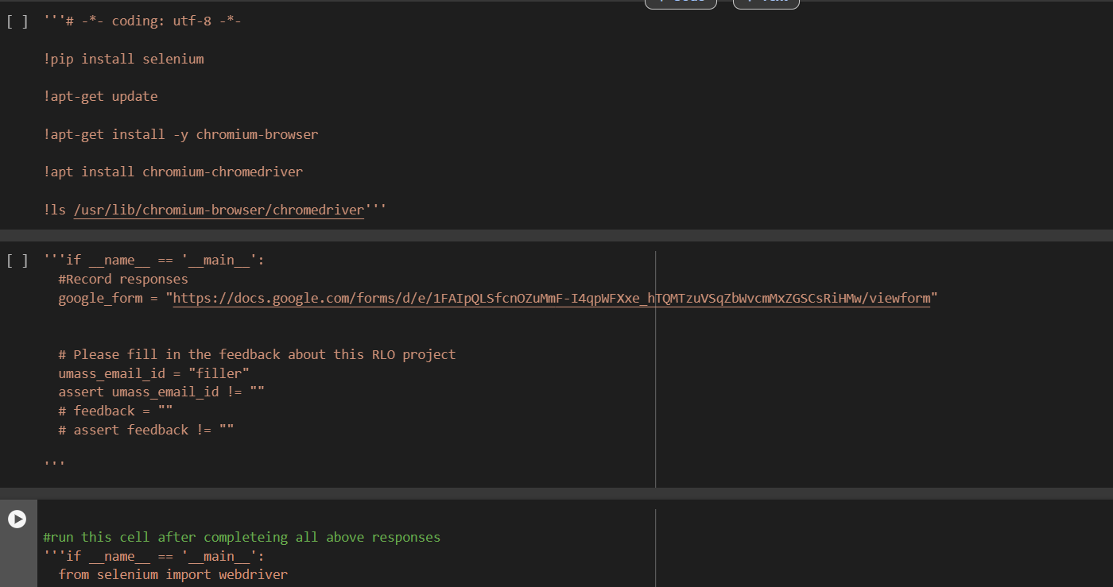
Filling in the Code
Survey/Attendance
Launching the Notebook
Launching the Script
Downloading and Saving the Notebook
Remember to run the last three cells and then comment out all the code inside them before proceeding

Slide 11
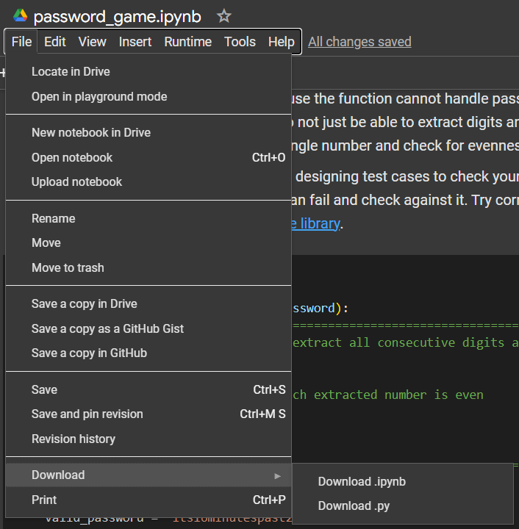
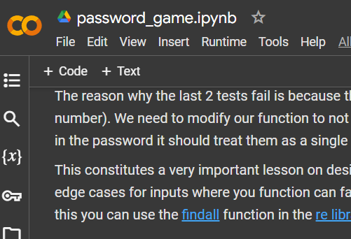
Filling in the Code
Survey/Attendance
Launching the Notebook
Launching the Script
Downloading and Saving the Notebook

Slide 12
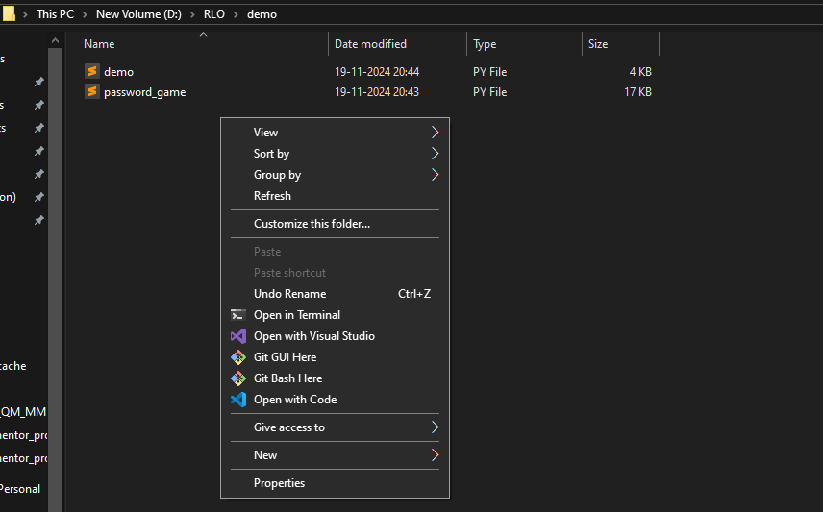
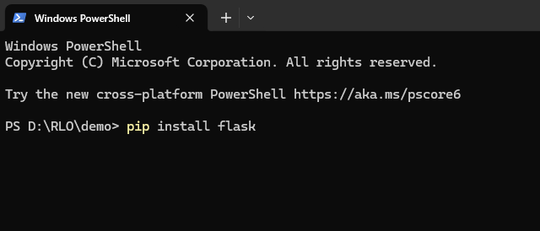
Filling in the Code
Survey/Attendance
Launching the Notebook
Launching the Script
Downloading and Saving the Notebook
Make sure you have the demo.py and password_game.py in the same folder!
Wait for flask to install
Left-click on the screen

Slide 13
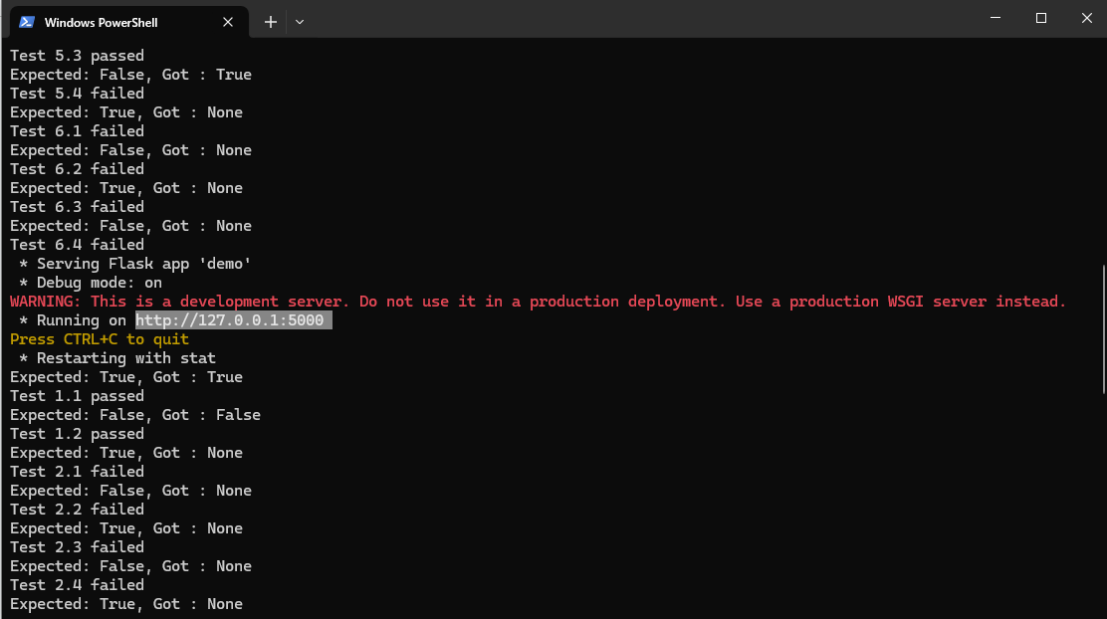
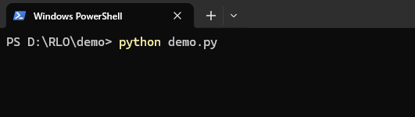
Filling in the Code
Survey/Attendance
Launching the Notebook
Launching the Script
Downloading and Saving the Notebook

Slide 14
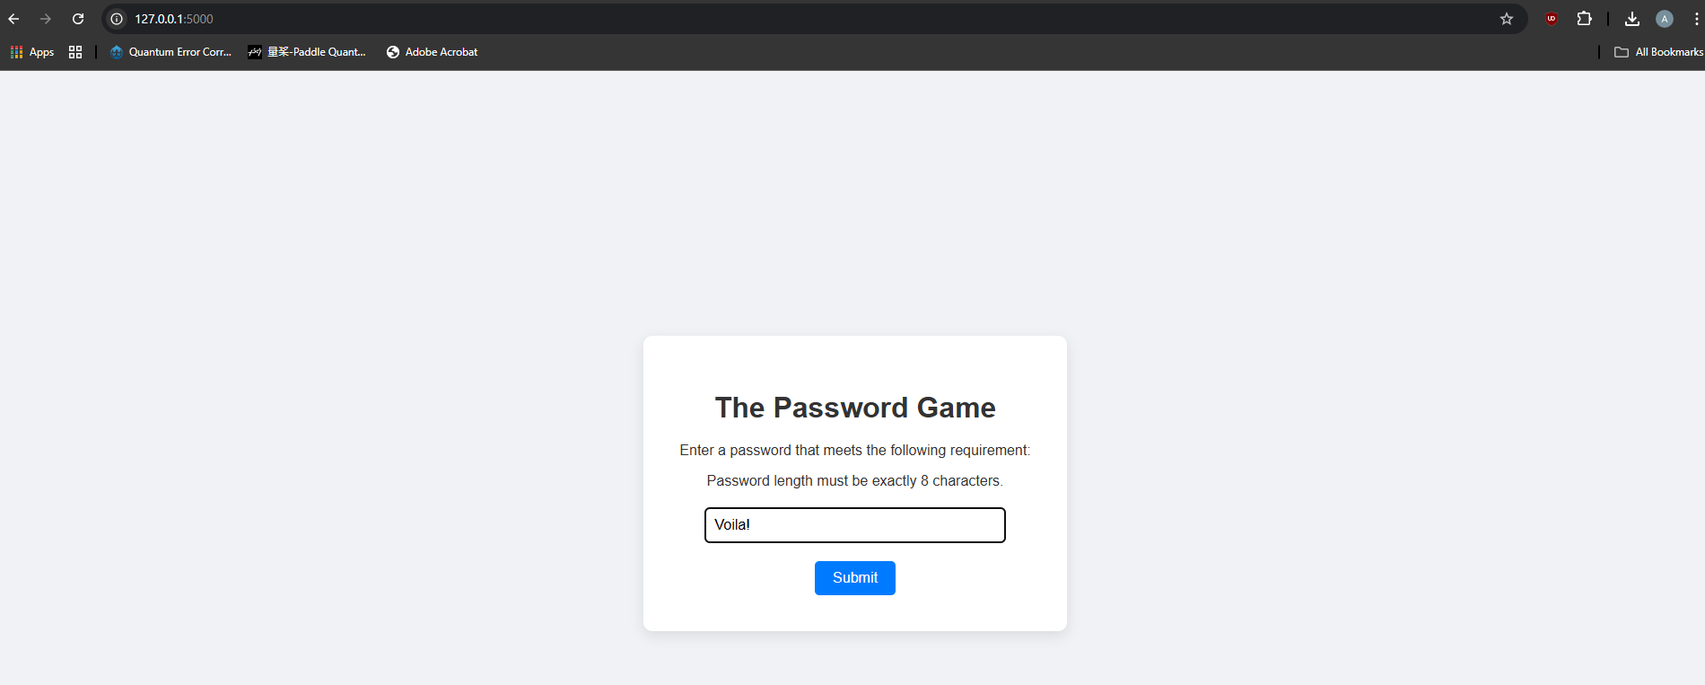
Filling in the Code
Survey/Attendance
Launching the Notebook
Launching the Script
Downloading and Saving the Notebook

Slide 15
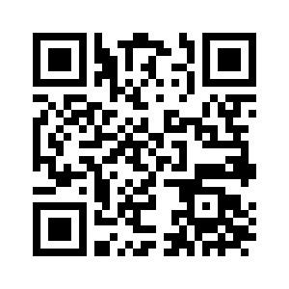
Filling in the Code
Survey/Attendance
Launching the Notebook
Launching the Script
Downloading and Saving the Notebook
https://forms.gle/K4jjhcfJobP69NrZ6

Slide 16
Thank You!

